Slide 1


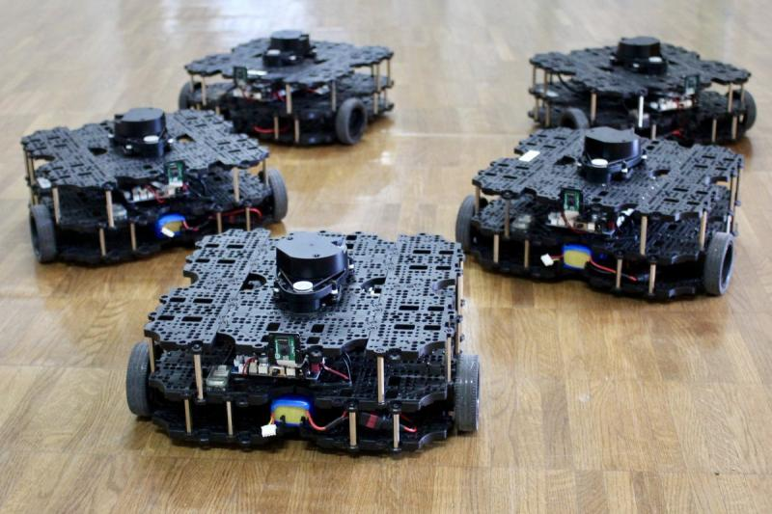

ECE693H, Spring 2025: Multi-robot System Design
“Multi-robot Systems 2”
Dr. Daniel Drew

Slide 2
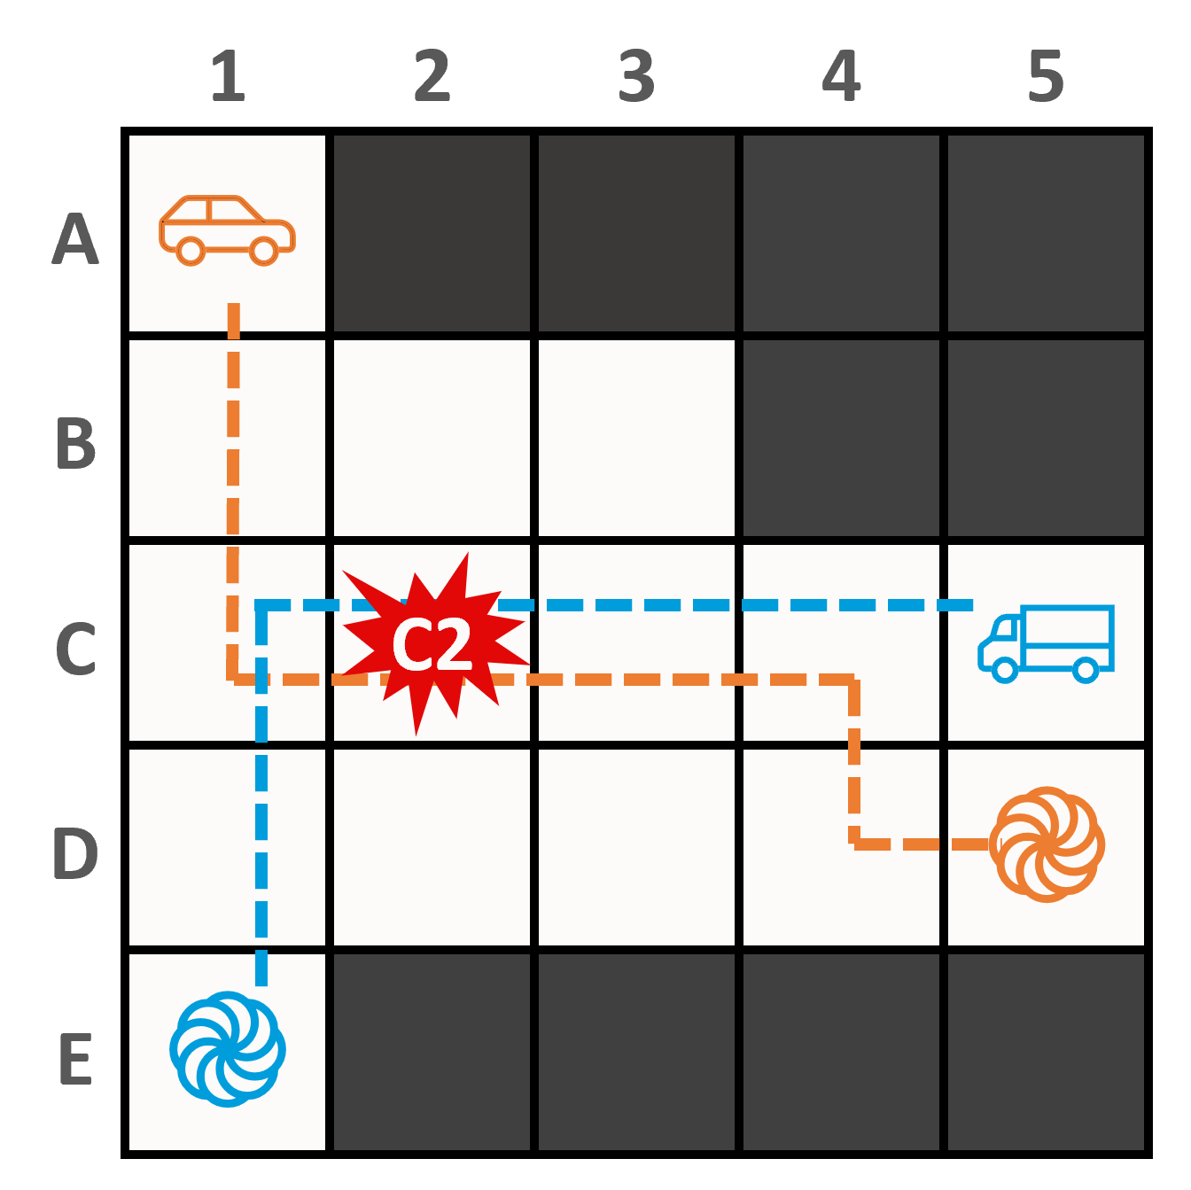
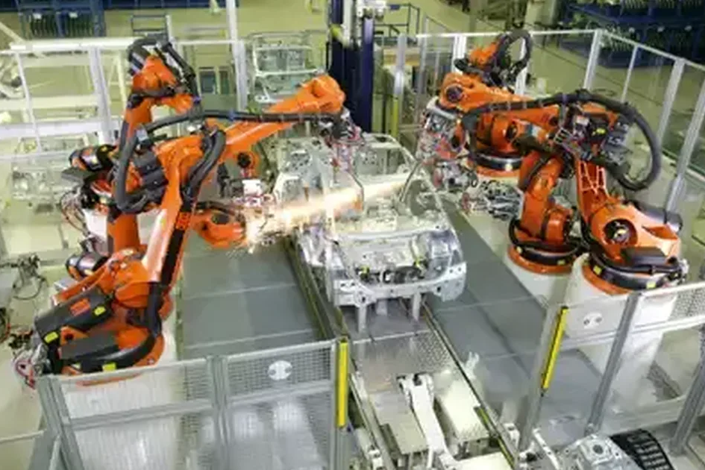
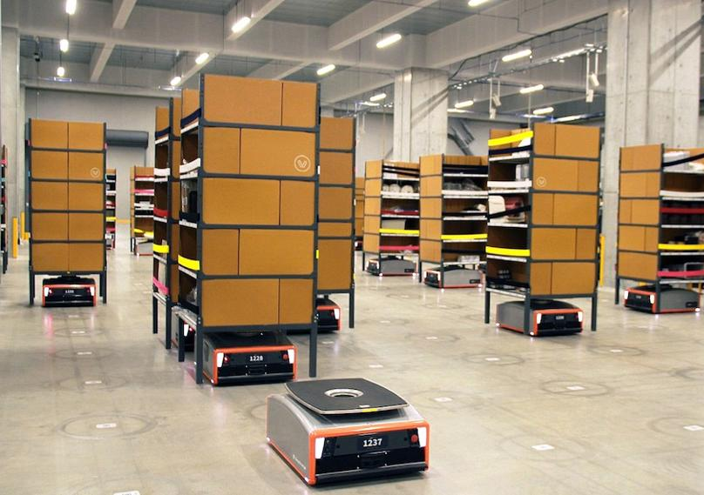
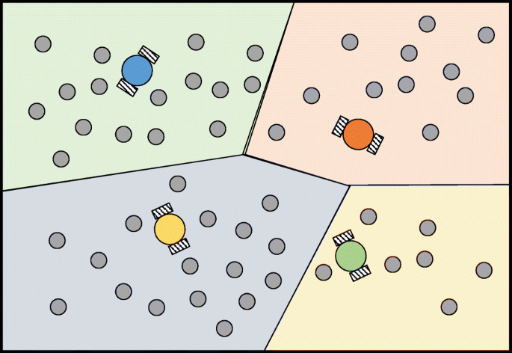

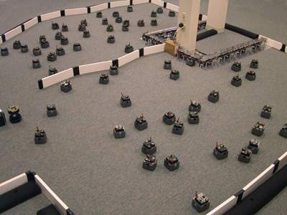
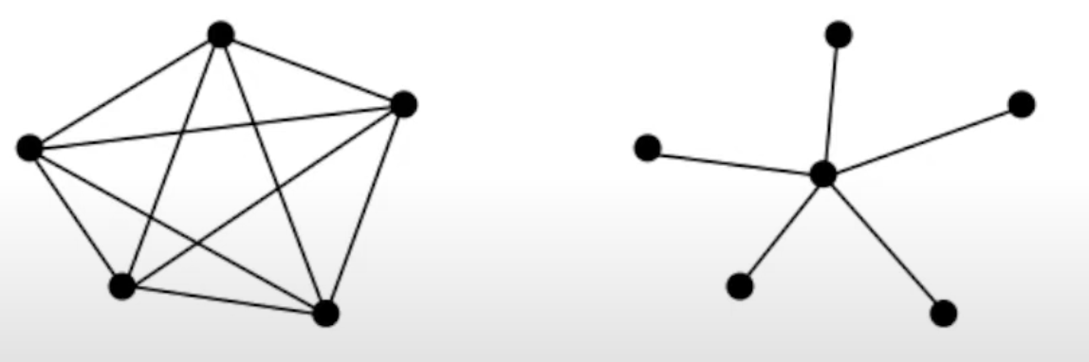
MRS Survey Recap
A group ( >1 ) of robots with a common objective

Slide 3
Questions?

Slide 4
Class Overview
Lecture (~20 minutes)
Astound the Class (~40 minutes)

Slide 5
Multi-robot Systems: Lecture 2 of 4
Lecture 1: MRS Survey
Lecture 2: Motion Planning
Lecture 3: Task Assignment (+Motion Planning if needed)
Lecture 3: Communication and Control Paradigms

Slide 6
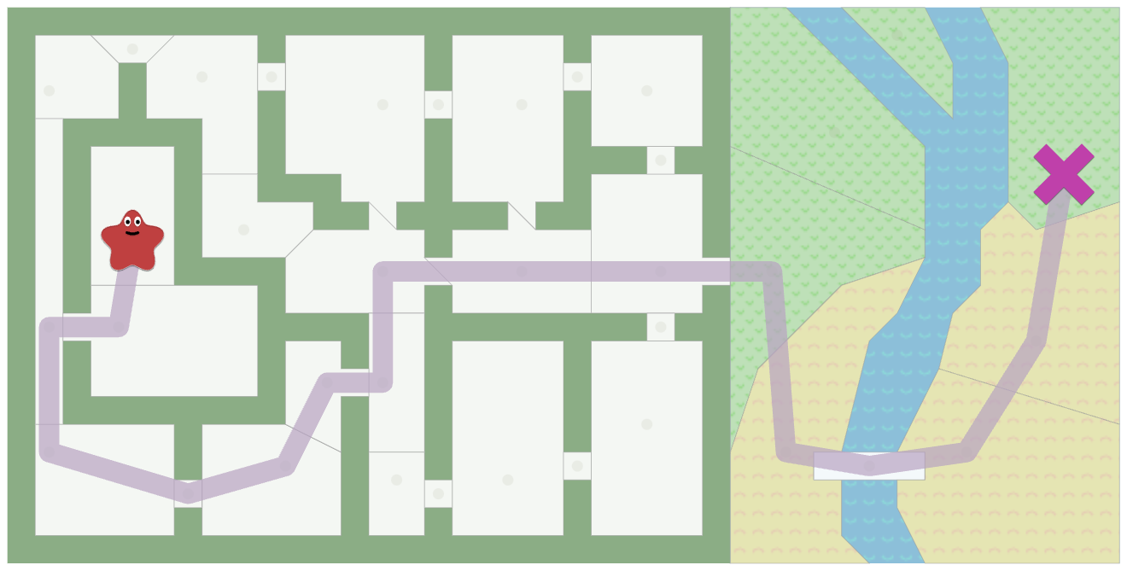
The Motion Planning Problem

Slide 7
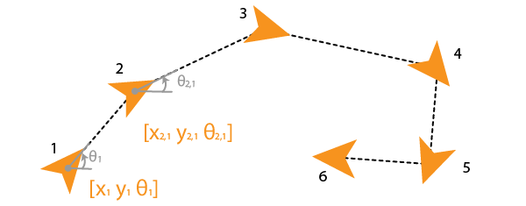
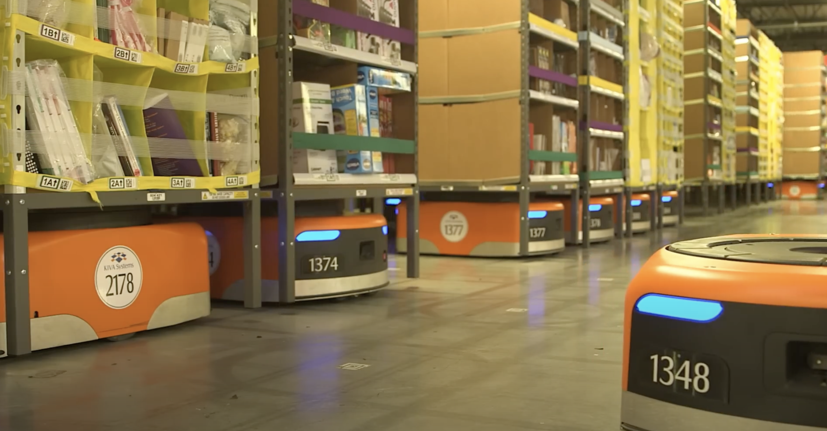

The Motion Planning Problem
What set of poses best gets the robot from A to B?

Slide 8
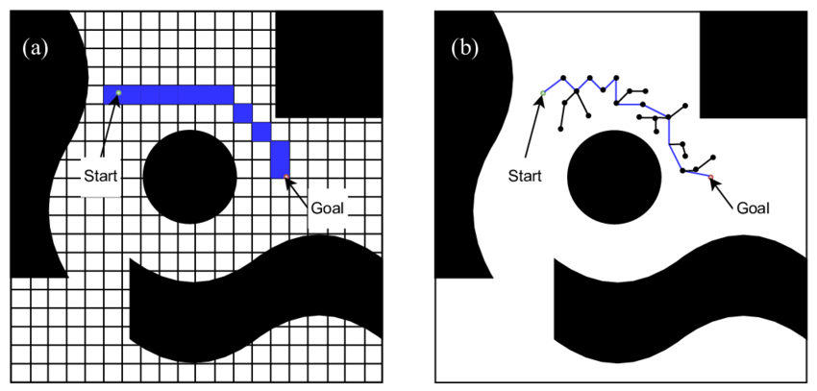

Review of Single-Robot Motion Planning
Search-based
Sample-based
Where each position is $p_{i}=\left[x_{i},y_{i},θ_{i}\right] or [x_{i},y_{i}]$
Notes:
https://www.redblobgames.com/pathfinding/a-star/introduction.html

Slide 9
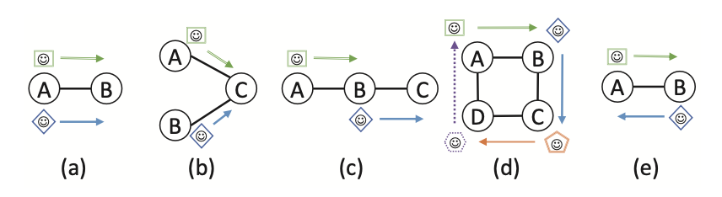
Multi-robot Motion Planning: Taxonomies
Search-based versus Sample-based
Same dichotomy!
Coupled versus Decoupled
Plan in the full (“global”) joint configuration space versus plan in individual (”local”) configuration spaces
Conflicts
(a) is an edge conflict, (b) a vertex conflict, (c) a following conflict, (d) a cycle conflict, and (e) a swapping conflict.

Slide 10
Single Robot Planning: A*

Slide 11
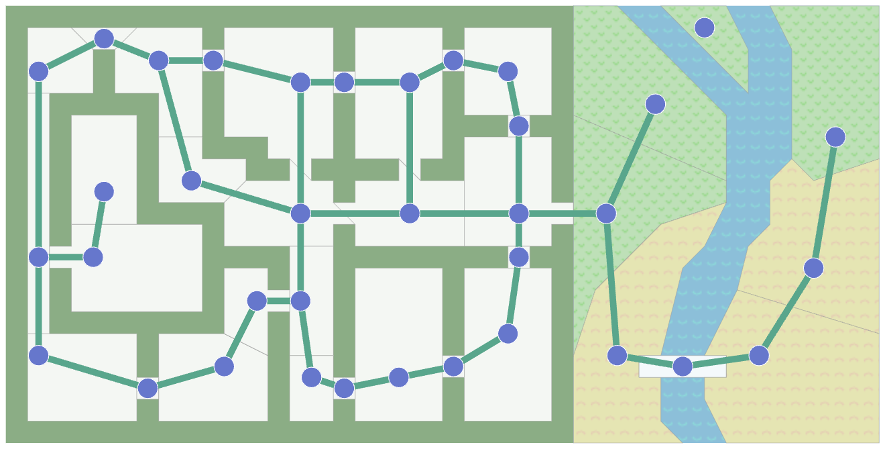
Single Robot Planning: A*

Slide 12
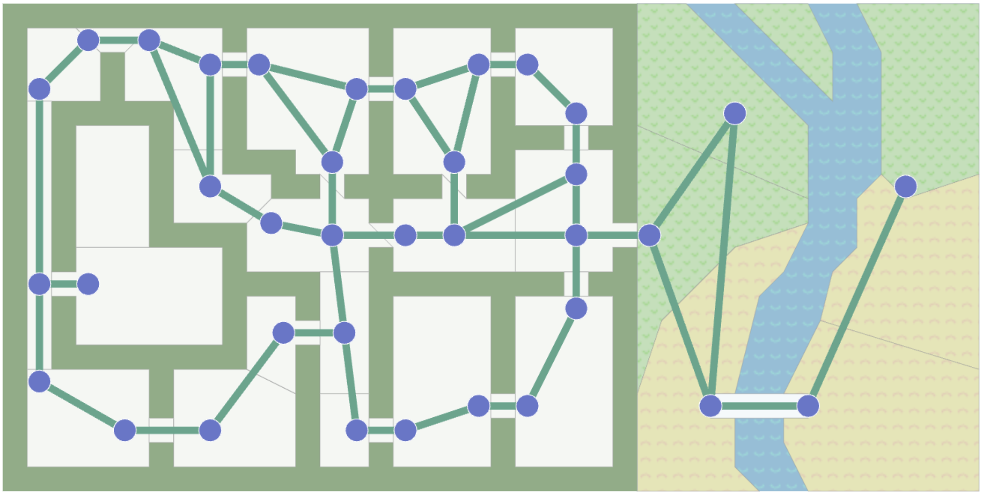
Single Robot Planning: A*
We can make choices about where nodes and edges go (e.g., doors)

Slide 13
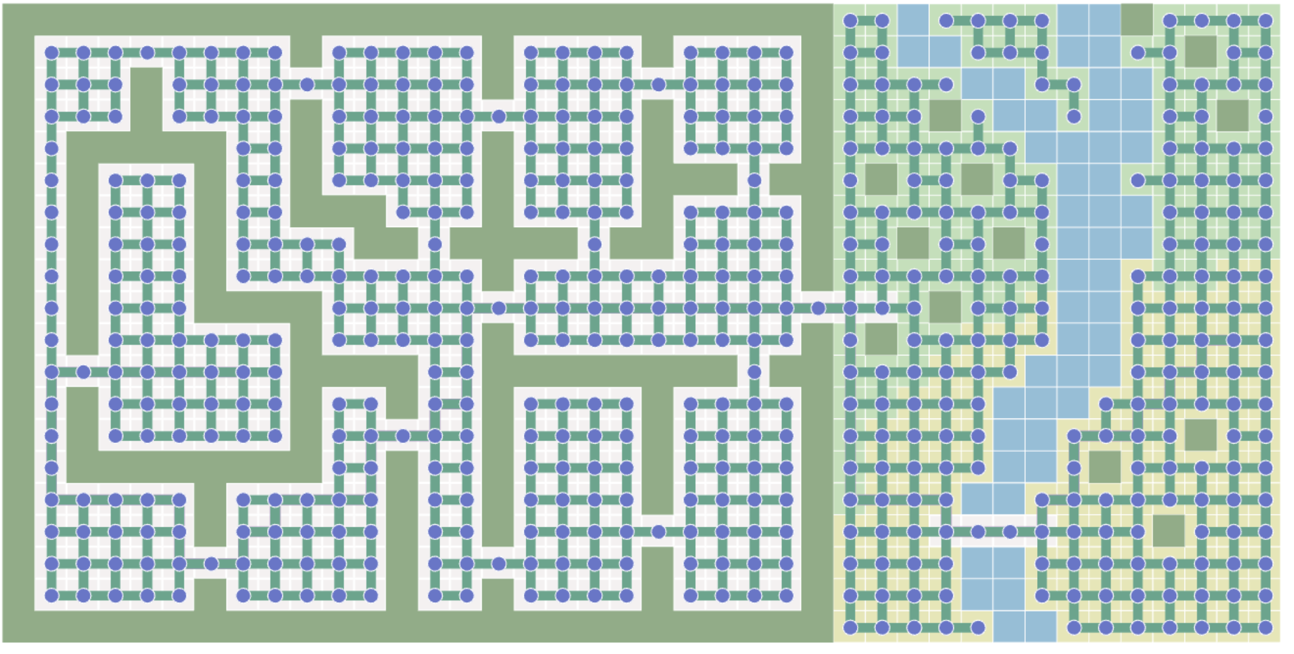
Single Robot Planning: A*
We can make choices about grid resolution

Slide 14
Single Robot Planning: A*
https://www.redblobgames.com/pathfinding/a-star/introduction.html

Slide 15
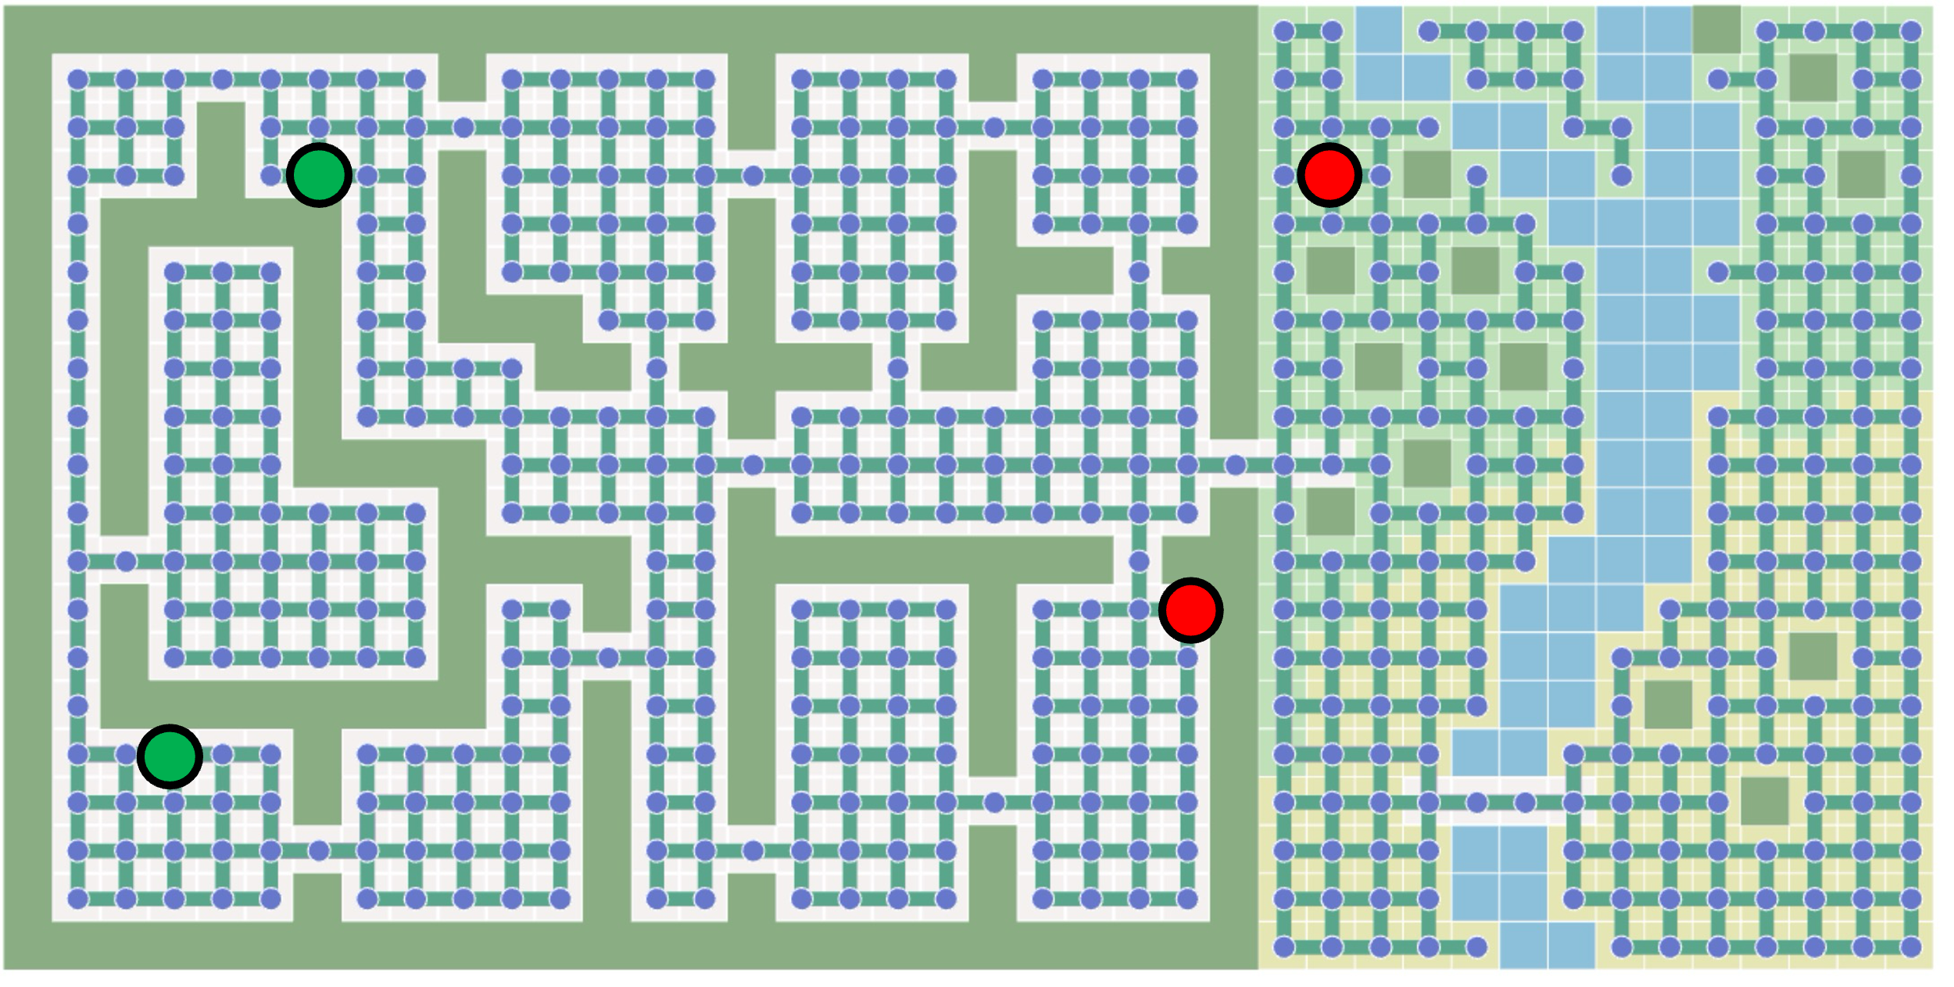
Search-based Methods for MRS

Slide 16
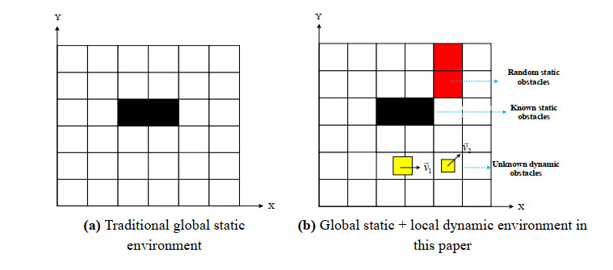
A* with Replanning: Local Repair (LRA*)

Slide 17
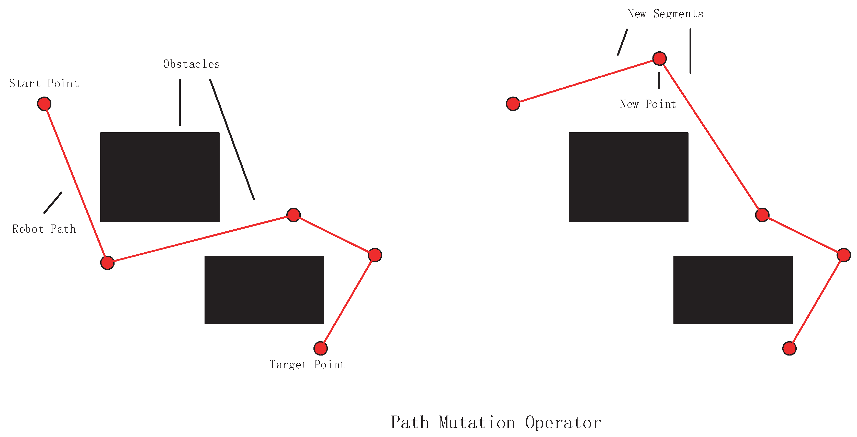
A* with Replanning: Local Repair (LRA*)
Don’t need to replan the entire route

Slide 18

A* with Replanning: Local Repair (LRA*)
Local replanning without additional rules leads to collision cycles.
One workaround: “agitation”: after a cycle, add random noise to the graph edges.

Slide 19
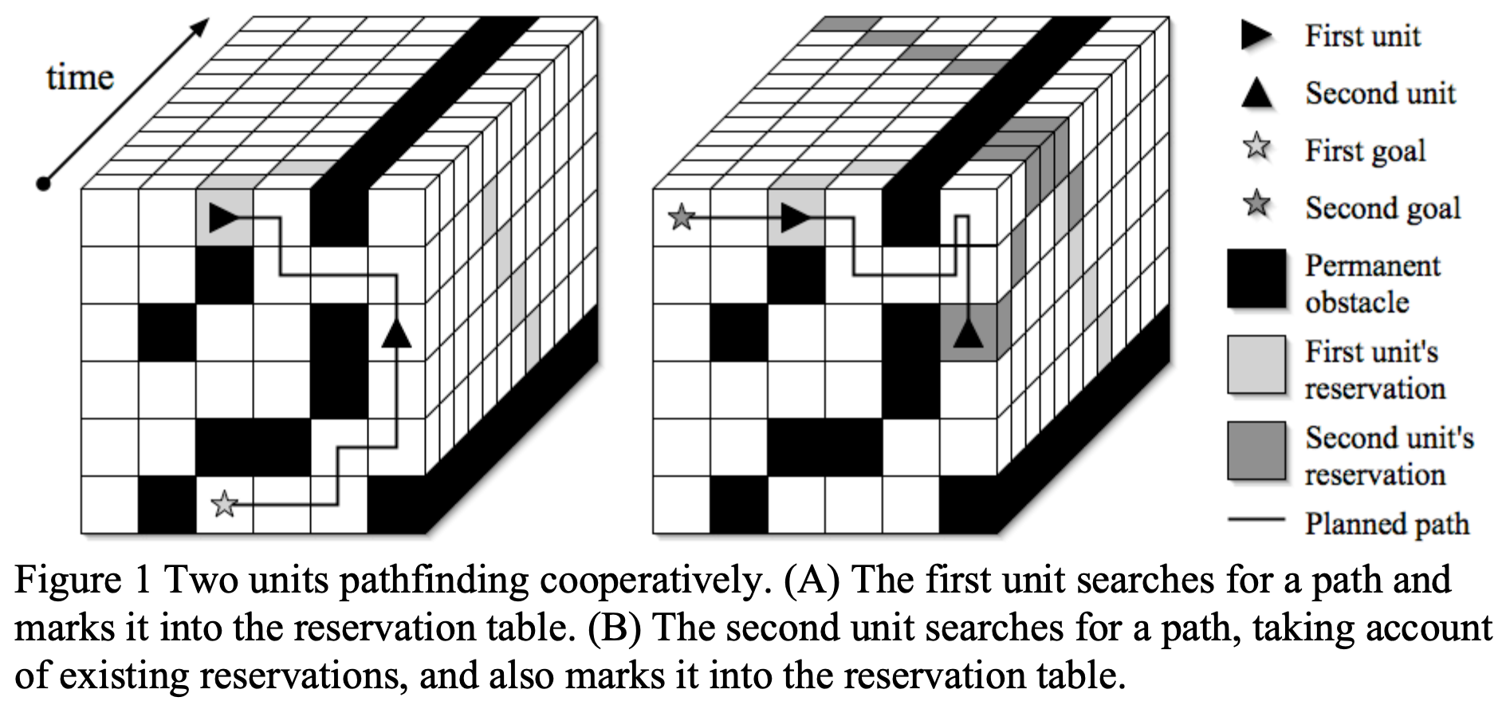
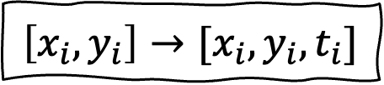

Cooperative A* (CA*)
$$\left[x_{i},y_{i}\right]→[x_{i},y_{i},t_{i}]$$
Add command $wait$
Challenge: curse of dimensionality

Slide 20
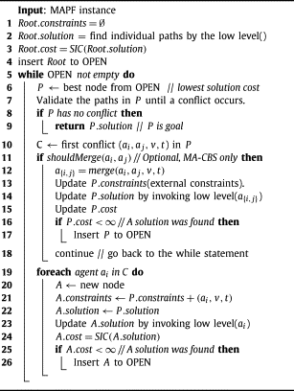
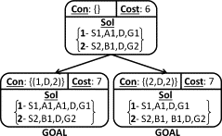


Conflict Based Search (CBS)
Conflict $(a_{i}, a_{j},v, t)$ (agent 1 and 2 occupy vertex at time)
Constraint $(a_{i}, v, t)$ (agent can’t occupy vertex at time)

Slide 21
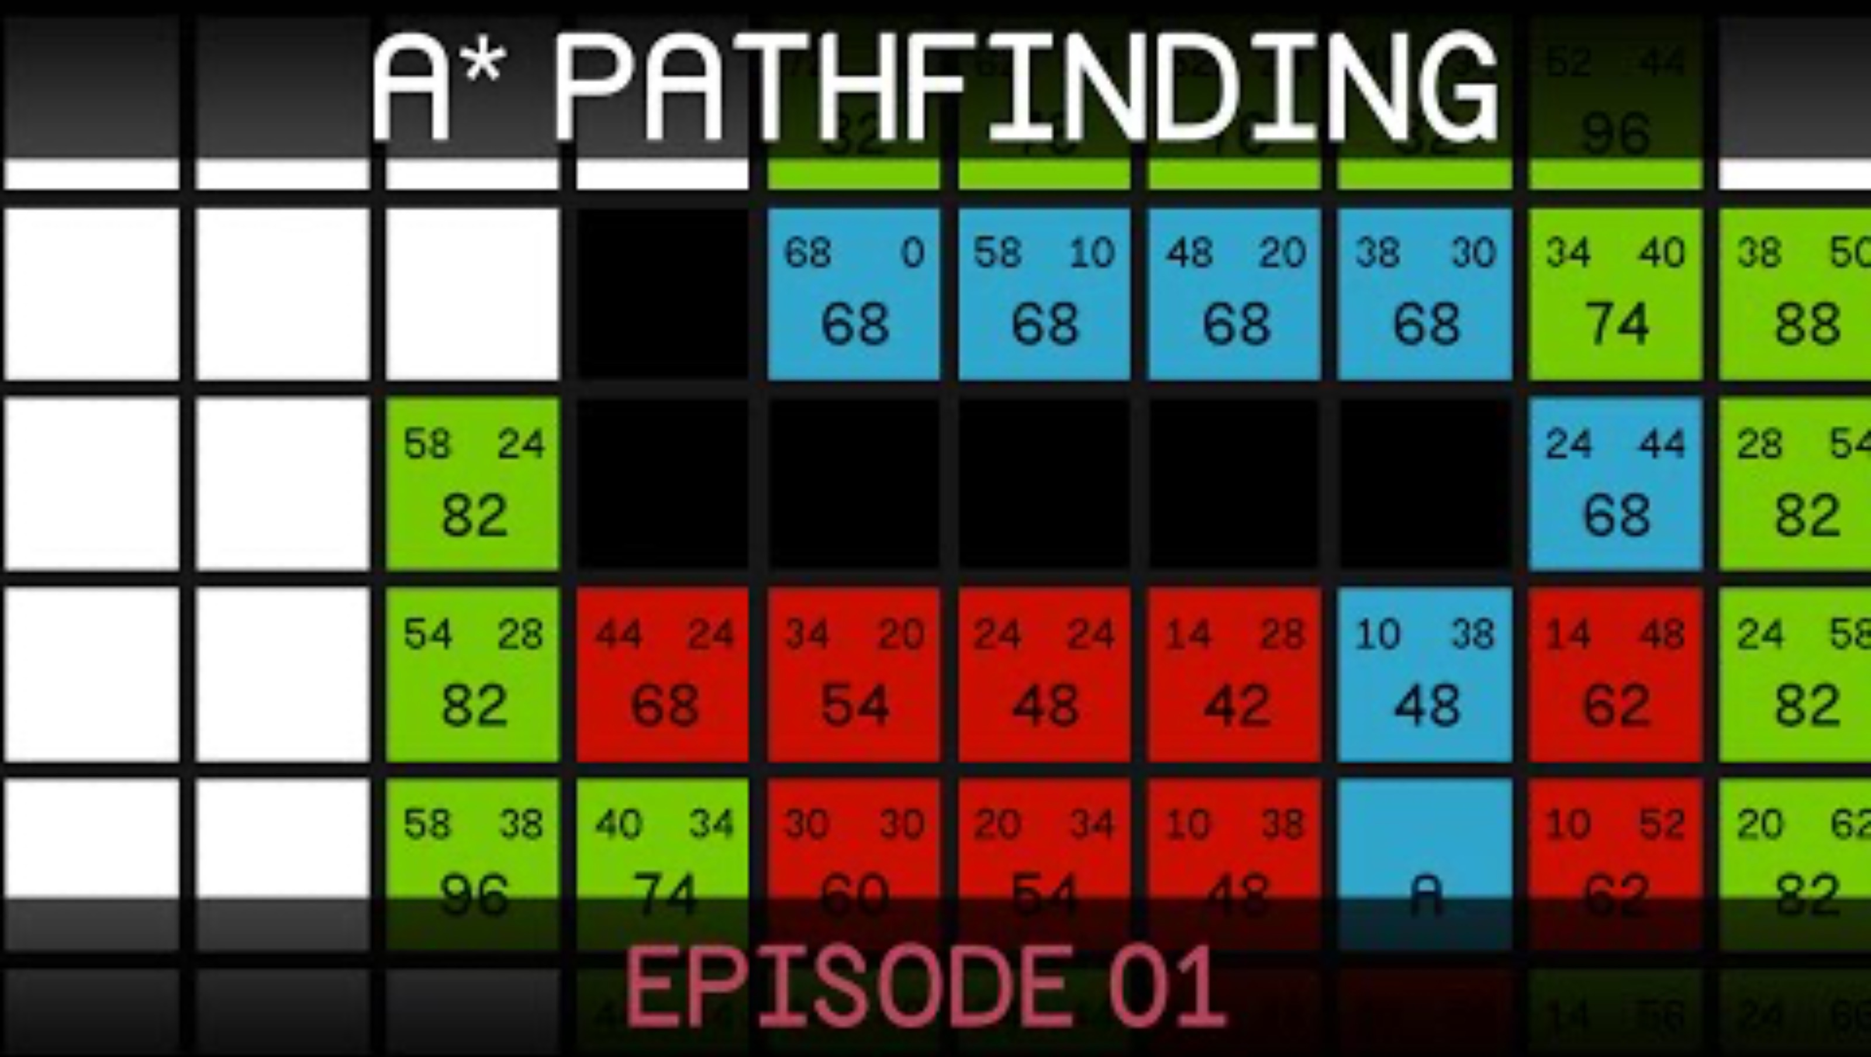
A* Recap Video

Slide 22
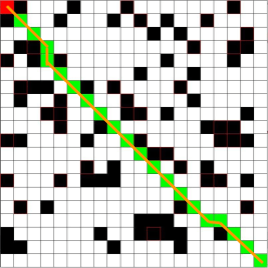
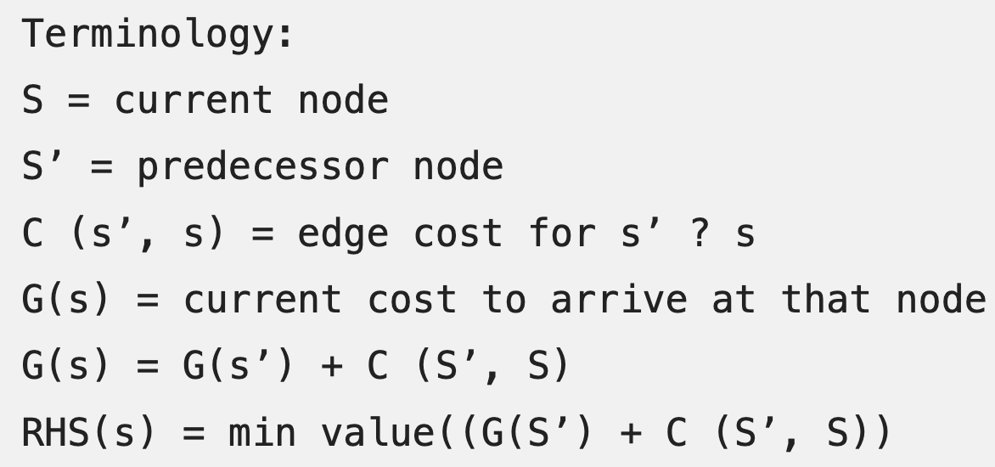
D* and D* Lite
Two separate lists maintained:
“G” score = Cost to connect the starting point to the current point
“RHS” score = Connection cost from current node to next node, inf. for obstacle; aka one-step lookahead cost
→when G(s) /=/ RHS(s), queue for update.

Slide 23
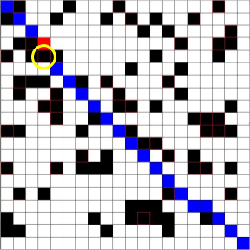
D* and D* Lite
Initial plan
Obstacle encountered

Slide 24
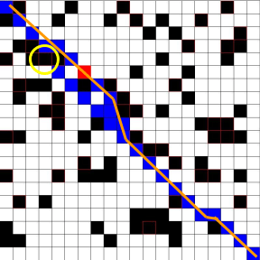
D* and D* Lite
Obstacle encountered
Plan updated

Slide 25
D* and D* Lite

Slide 26
Contrasting These Approaches
A* with replanning:
Initial planning: A*
Replanning: Re-run A*
Efficiency: Poor
Optimality: High
D* Lite:
Initial planning: A*-ish in reverse
Replanning: Update lookahead cost RHS(s)
Efficiency: High
Optimality: Variable
D* Lite for mostly dynamic environments, A* for mostly static

Slide 27
Single Robot Planning: Sampling-based Methods
What do we do if we have no grid, or the required grid dimensions make computation infeasible, or we have many degrees of freedom?
Succinctly: Sampling-based methods are good for large-scale, continuous environments with high-dimensional robots

Slide 28
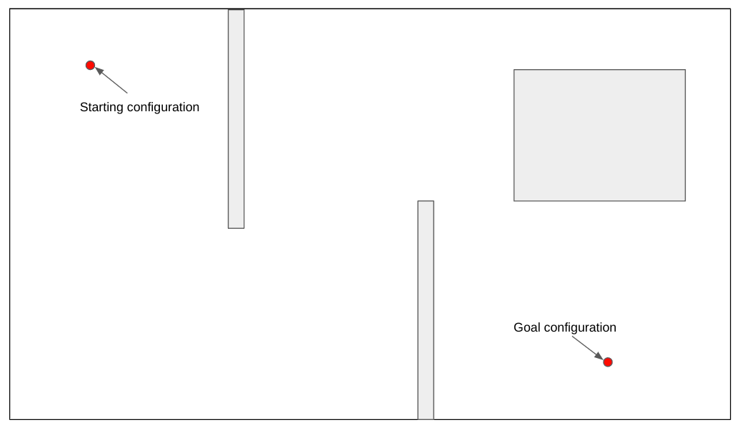
Single Robot Planning: Probabilistic Roadmap (PRM)

Slide 29
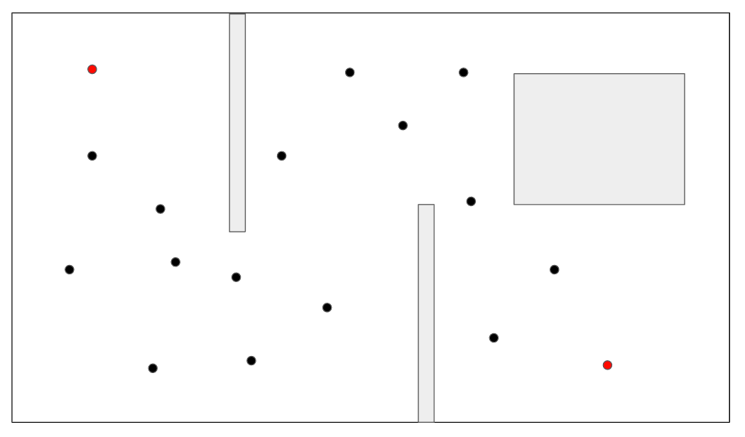
Single Robot Planning: PRM

Slide 30
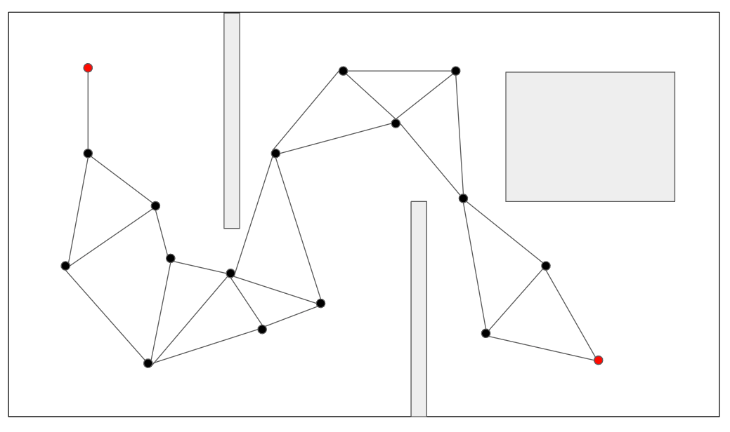
Single Robot Planning: PRM

Slide 31
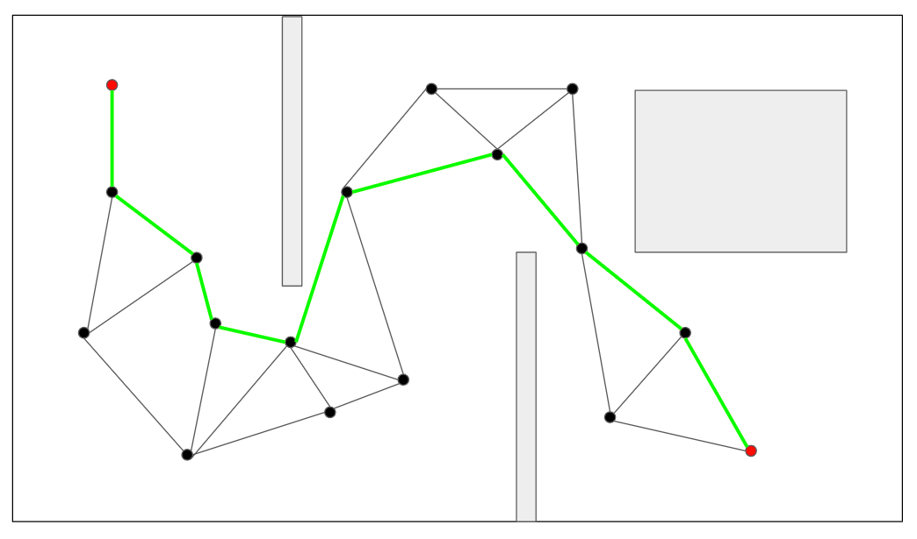
Single Robot Planning: PRM

Slide 32
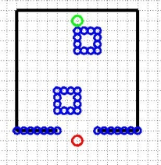
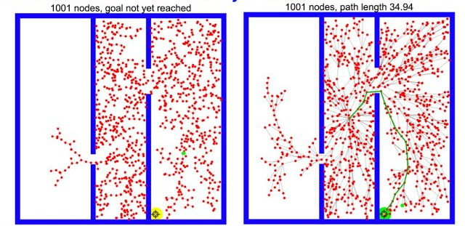
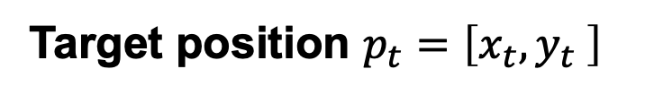
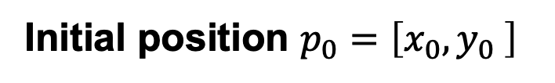
Single Robot Planning: RRT
Instead of a discretized grid, positions are sampled from the continuous state space
(grid in images shown for visualization only)
Initial position $p_{0}=\left[x_{0},y_{0} \right]$
Target position $p_{t}=\left[x_{t},y_{t} \right]$
https://theclassytim.medium.com/robotic-path-planning-rrt-and-rrt-212319121378

Slide 33
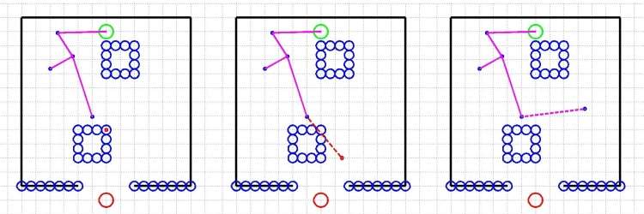
Single Robot Planning: RRT
Points are added to the “tree”, then checked for 1) collisions with obstacles, 2) collisions with obstacles between nodes
https://theclassytim.medium.com/robotic-path-planning-rrt-and-rrt-212319121378

Slide 34
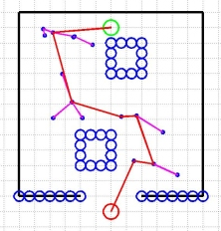
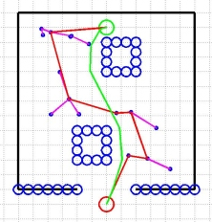
Single Robot Planning: RRT
Valid path formed to target
Path can be “smoothed” by re-sampling between path points
https://theclassytim.medium.com/robotic-path-planning-rrt-and-rrt-212319121378

Slide 35
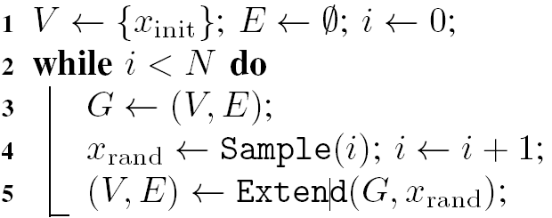
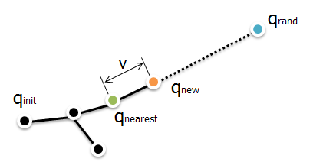
Single Robot Planning: RRT
Find the nearest node in tree
Generate a new node in direction of sampled node
Collision check
Add new node to tree
Return status (reached/advanced/trapped)
https://theclassytim.medium.com/robotic-path-planning-rrt-and-rrt-212319121378

Slide 36
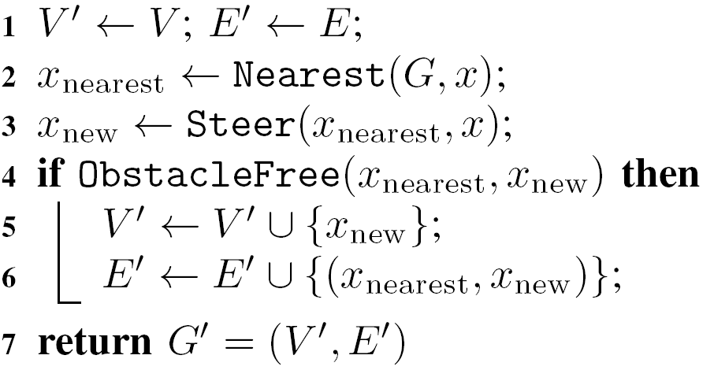
Single Robot Planning: RRT
https://theclassytim.medium.com/robotic-path-planning-rrt-and-rrt-212319121378

Slide 37
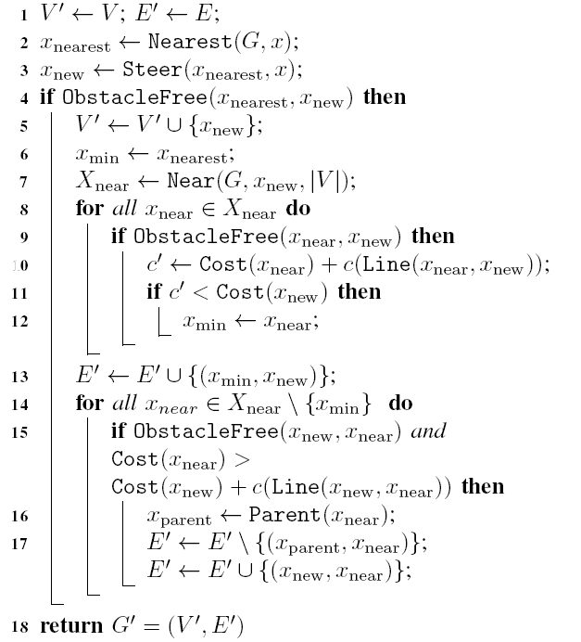
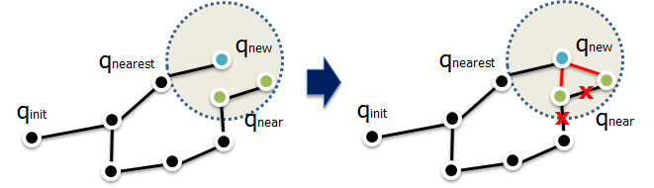
Single Robot Planning: RRT*
Continuously “rewire” the graph based on closest vertices
Find the nearest node in tree
Generate a new node in direction of sampled node
Collision check
Check whether new node is closer to any existing nodes
Rewire tree to result in lowest total cost path
https://theclassytim.medium.com/robotic-path-planning-rrt-and-rrt-212319121378

Slide 38
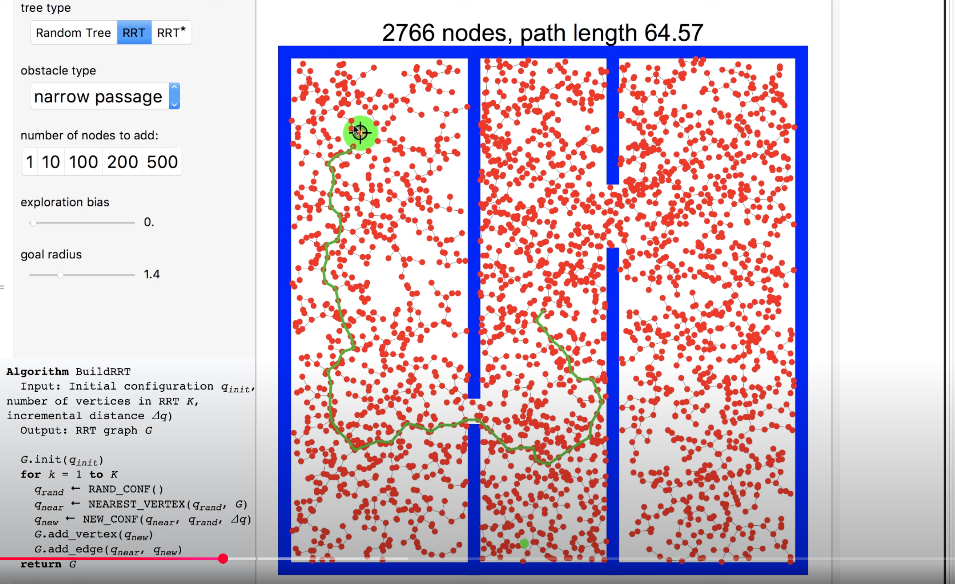
Single Robot Planning: RRT Visualized

Slide 39
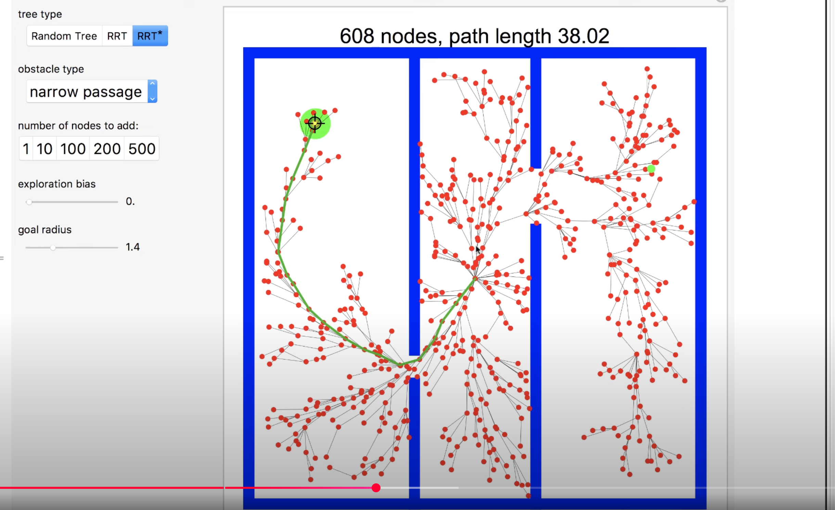
Single Robot Planning: RRT* Visualized

Slide 40
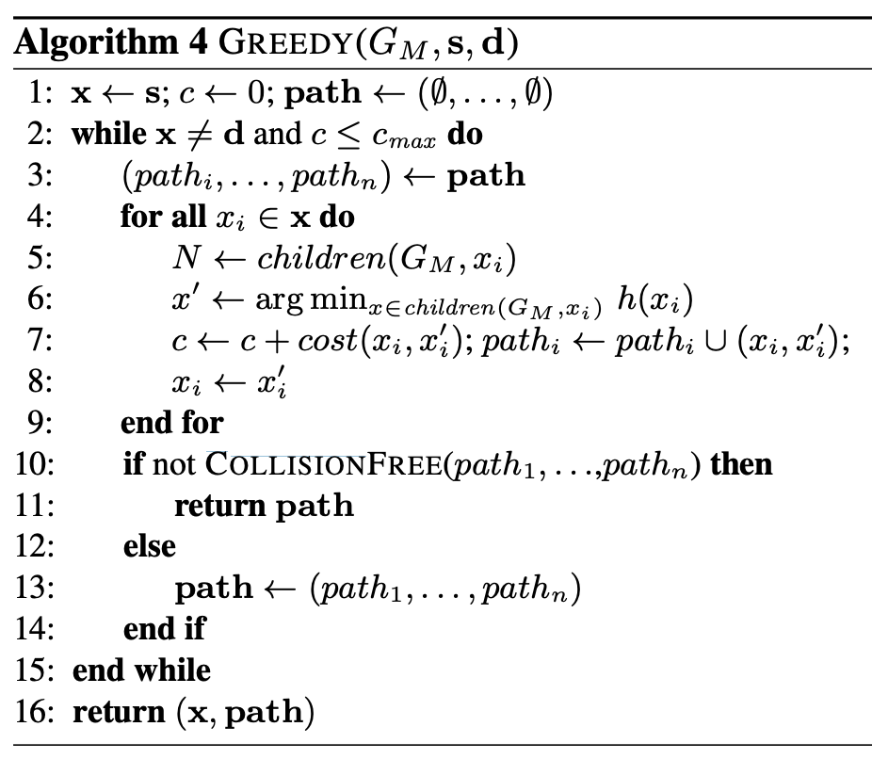
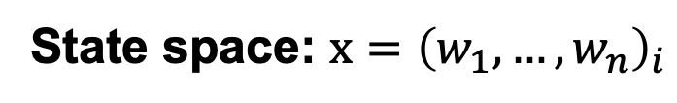
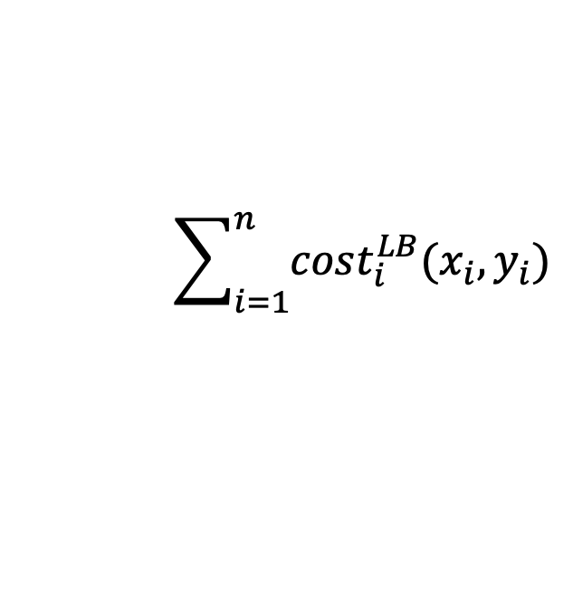
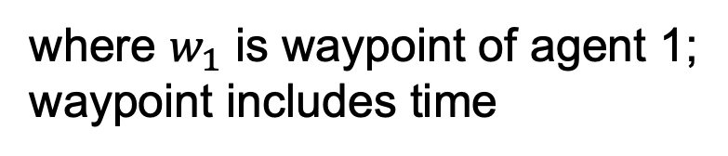
Multi-Agent RRT (MA-RRT*)
(first extend RRT* with G-RRT*, which discretizes state space into a motion graph; when expanding from start, still samples points randomly, then uses graph-based search to find optimal path)
where $w_{1}$ is waypoint of agent 1;
waypoint includes time
Then consider:
State space: $x={\left(w_{1}, …, w_{n}\right)}_{i}$
$$\sum_{i=1}^{n}{cost_{i}^{LB}(x_{i},y_{i})}$$
Distance between two joint spaces:
(obviously, this hurts our spatial intuition)

Slide 41
Discrete RRT (dRRT / dRRT*)
First compute individual optimal roadmaps using G-RRT*
THEN sample from joint configuration space of the roadmaps
Why? The joint configuration space is highly dimensional; faster to solve individual roadmaps then only sample and replan from those “good” solutions

Slide 42
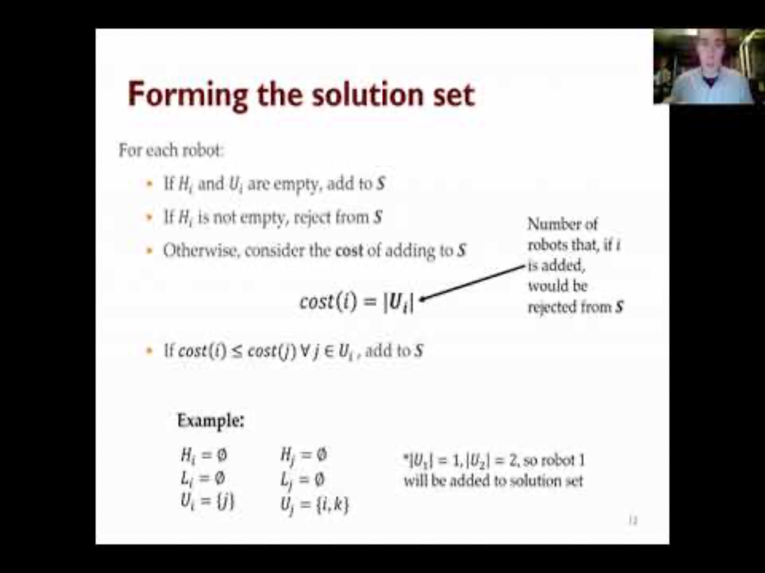
Decentralized RRT (dRRT*)

Slide 43
Quick Summary
For scenarios with an omniscient planner: A* is ubiquitous (e.g., video games)
For highly dynamic environments: D*-lite is state of the art
For large, high-dimensional state spaces: dRRT* is state of the art
Multi-agent coordination: D*-lite does not explicitly account for other robots!
Common approach: “prioritized planning”, where high-priority robots maintain their path, low-priority robots must replan.

Slide 44
Lecture (~20 minutes)
Subsystem check-in (~40 minutes)
Questions?
Questions?
Lecture 1: MRS Survey
Lecture 2: Motion Planning
Lecture 3: Task Assignment (+Motion Planning if needed)
Lecture 3: Communication and Control Paradigms

Slide 45

693H Robotic Subsystems
-Second Design Review Presentations are 3/10, 3/12
-You will be expected to have functional prototypes complete to show by then
-You will be expected to have PCB designs and final BoMs complete by then

